Slide 1
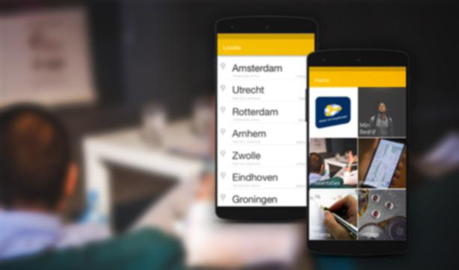

KvKickstart
Notes:
Introduction

Slide 2

Startersdag
Notes:
Our expirence -> startersdag
Problem; to much information

Slide 3

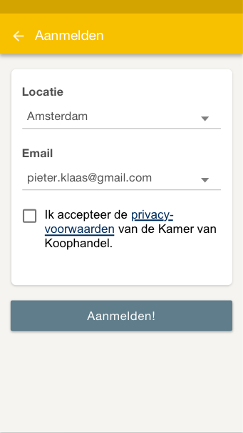
The solution
An app that gives an total overview about information and inspiration of the presentations you like about the Startersdag van the Chamber of Commerce.
Notes:
The solution

Slide 4
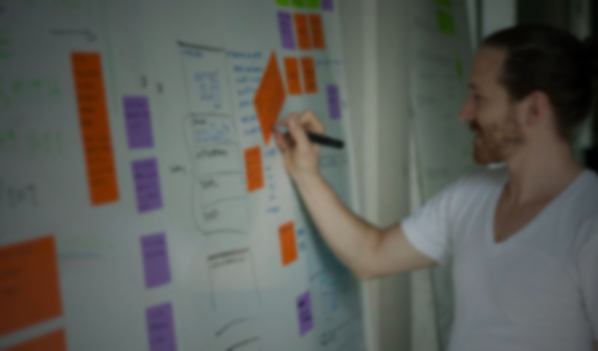
The concept is easy
1.
Attent a 'Startersdag' event near you
2.
Collect information and inspiring ideas
3.
Bring it all together and start your business
Notes:
How the app can be used

Slide 5

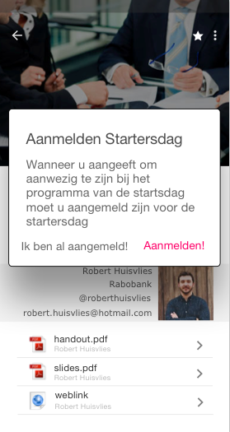
Functionality
Sign up for the event
Overview of the presentations
Create your own time schedule
Venue map
Download resource files
Adding notes
Checklist
Notes:
Functionality about app description

